Slide 1
Cyberminer – A web search engine Iteration 1
Team members:
Tingwei Wu txw190006
Churong Zhang cxz173430
Feifei Guo fxg180009
Qixiang Wang qxw200000

Slide 2
Functional Requirements(1)
FR1. Case sensitive search
FR2. Hyperlink enforcement
FR3. Deletion of out-of-date URL
FR4. Multiple search engines

Slide 3
Functional Requirements(2)
FR5. Setting the number of results to show per page, and navigation between pages
FR6. Listing of the query result in ascending alphabetical order; most frequently accessed order, or per payment
FR7. Autofill, while correcting typographical errors
FR8. Specifying OR/AND/NOT Search
FR9. Filtering out symbols that are not meaningful, according to the user configuration

Slide 4
Non-Functional Requirements
Easily understandable
Portable
Reusable
Good performance
User-friendly

Slide 5
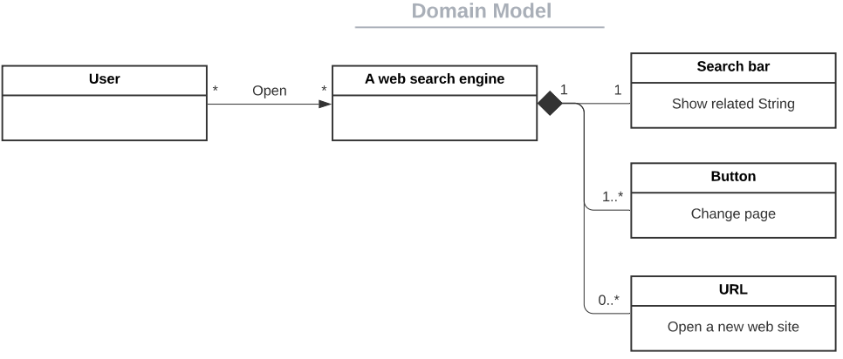
1. Domain Modeling & Requirements specification

Slide 6
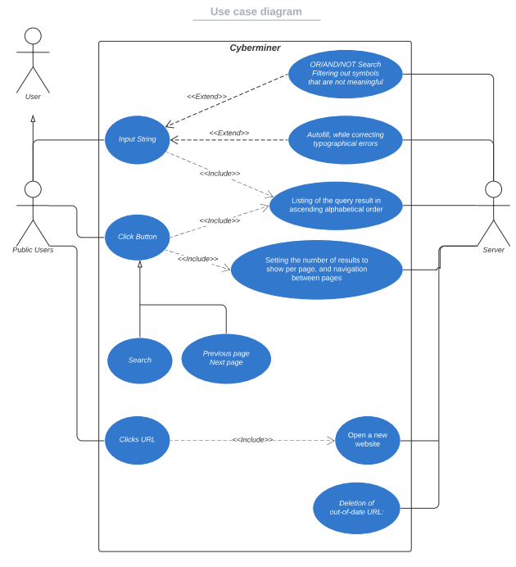
Main Use Case

Slide 7
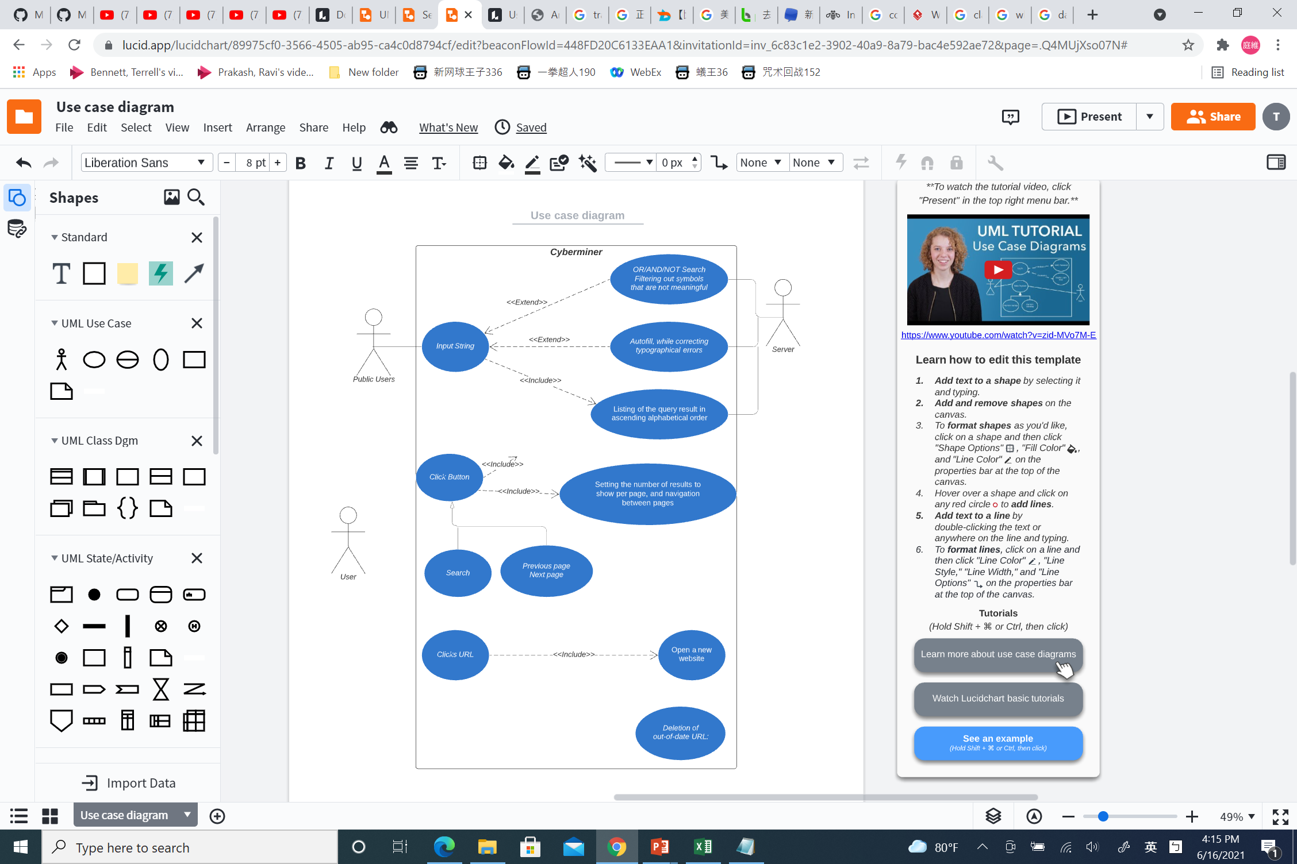
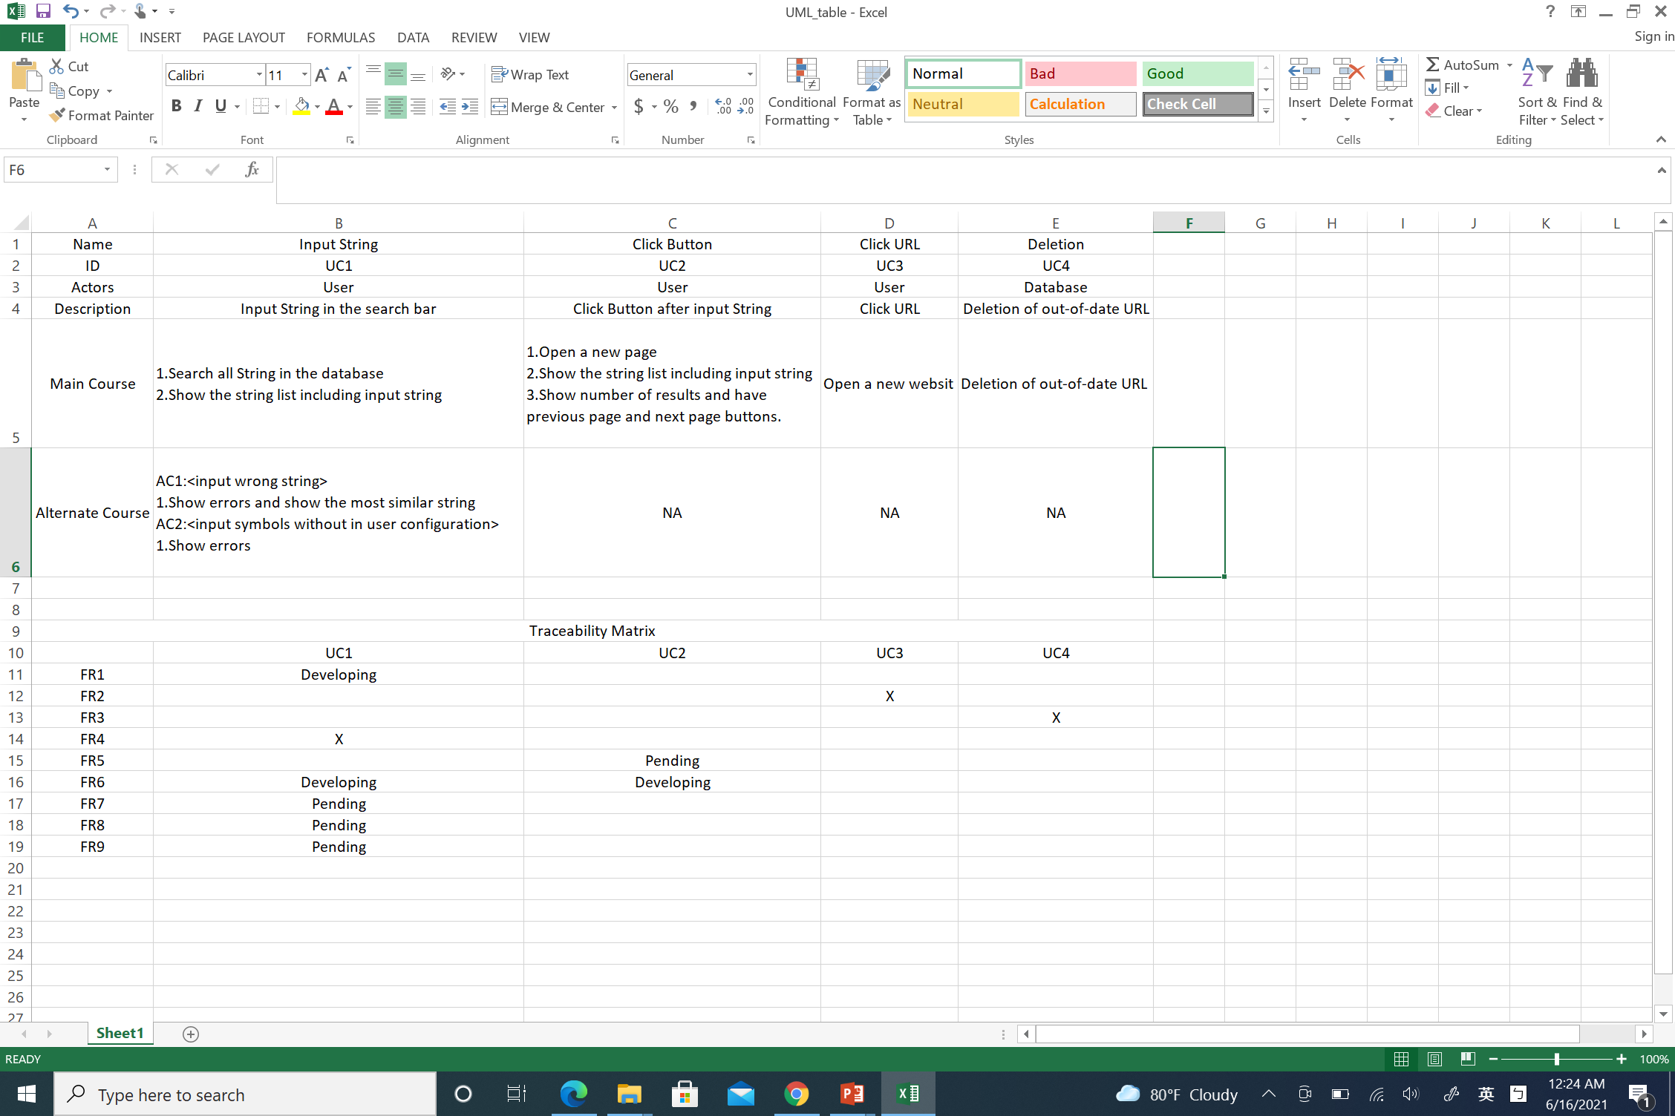
Use Case 1

Slide 8
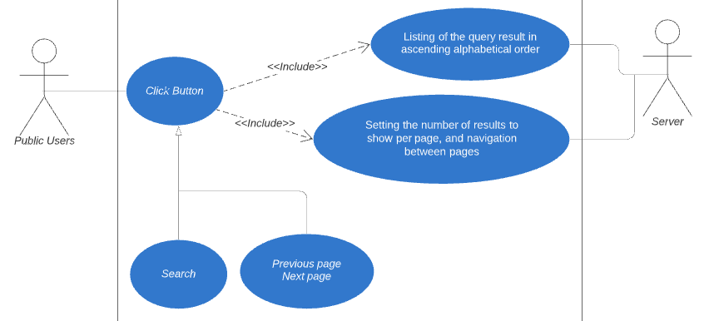
Use Case 2

Slide 9
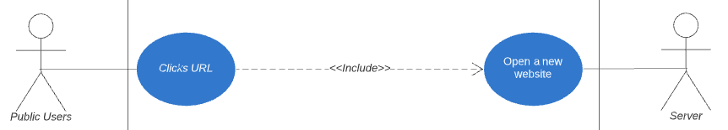
Use Case 3

Slide 10

Use Case 4

Slide 11
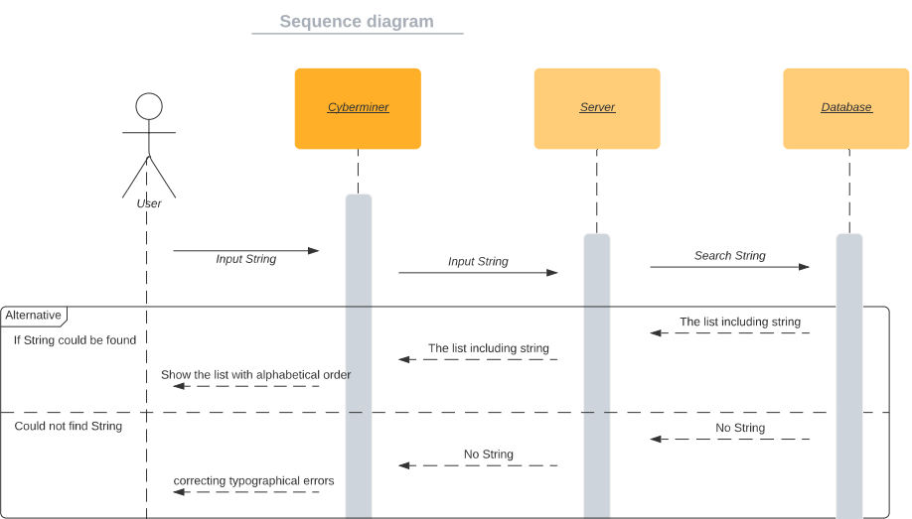
Sequence Diagram(1)
Use Case 1(Input String)

Slide 12

Sequence Diagram(2)
Use Case 2(Input String with Symbols)

Slide 13

Sequence Diagram(3)
Click search and Click URL

Slide 14
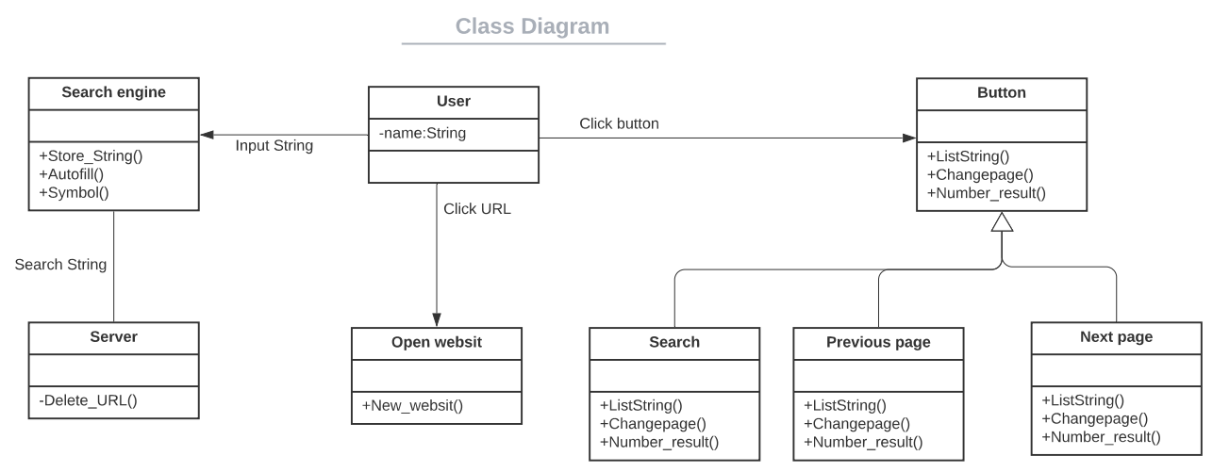
Class Diagram

Slide 15
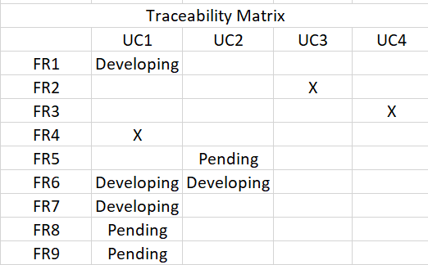
2. (Architectural) Design specification

Slide 16
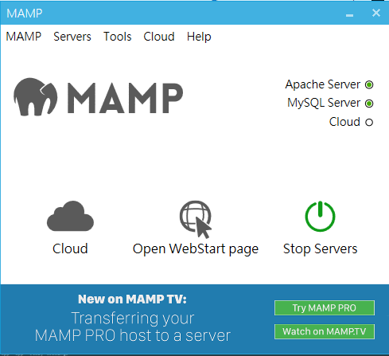
3. A Prototype implementation & User Manual
Download and Install MAMP
Activate Apache and MYSQL Server

Slide 17
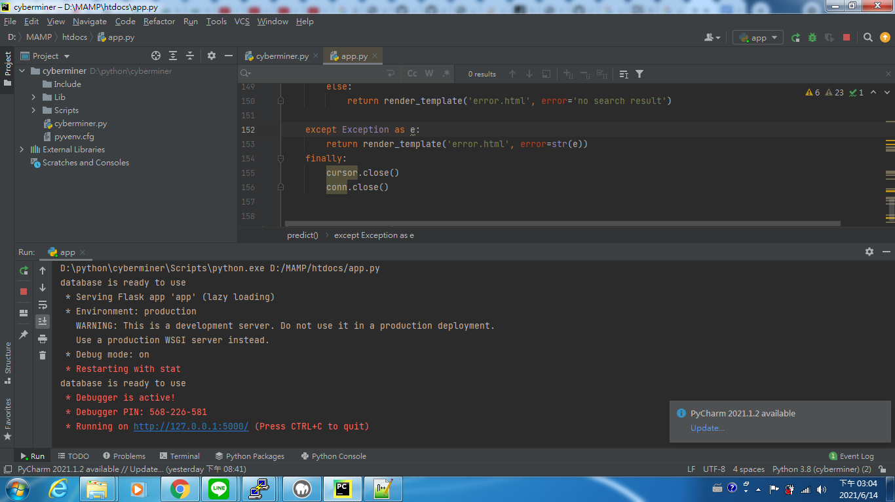
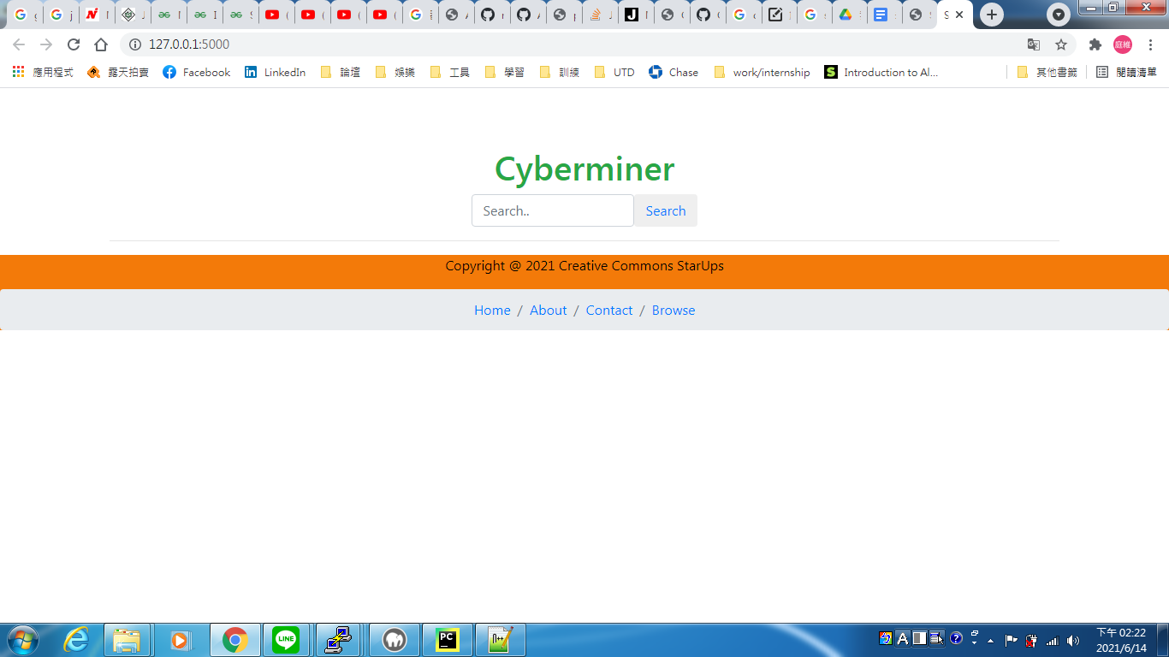
Execute app.py
Open the URL

Slide 18
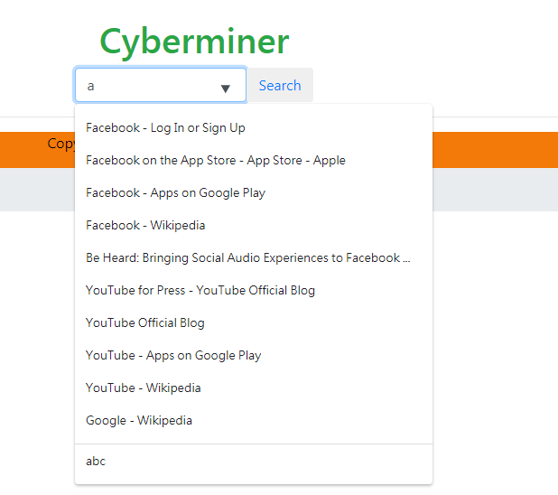
Input String and showing String in the Database

Slide 19
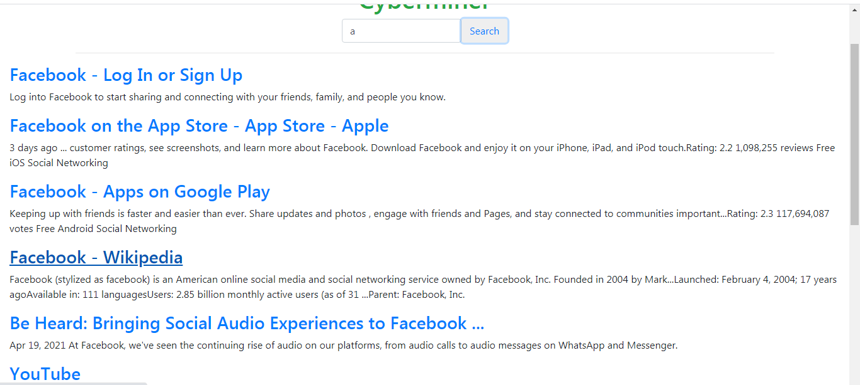
Click Search button and show the results

Slide 20
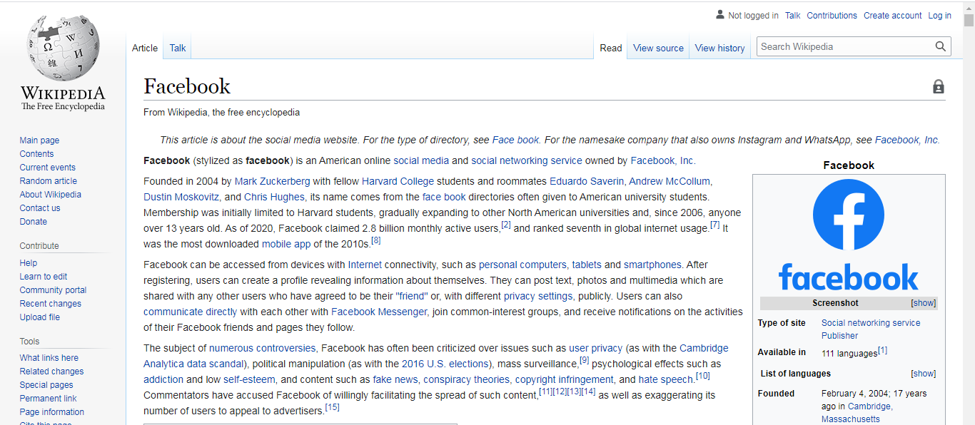
Click Facebook – Wikipedia

Slide 21
END

